Slide 1


Predicting the NBA’s next Most-Improved-Player
By: Jason zhang, Kody yuen, and corey an

Slide 2
background
What is the MIP award?
MIP is awarded to the player that has shown the most progress during the regular season.
How does MIP voting work?
100 ballots are cast which rank three players first, second, and third place. Each rank is worth 5, 3, and 1 point, respectively. Whoever gets the most points wins the award

Slide 3
potential impact/applications
Provides useful info to teams
Provides useful info for other awards
Money

Slide 4
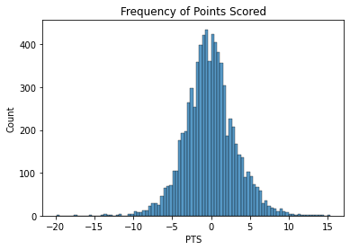
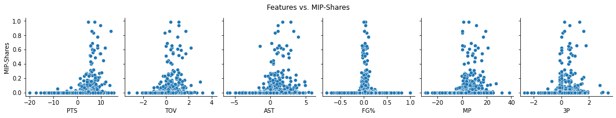
data exploration highlights
Histogram distribution is normal and centered left of 0, indicates that the average change in points scored is negative.
Pair plots reveal positive correlation between improved performance in subsequent seasons and MIP-shares received.

Slide 5
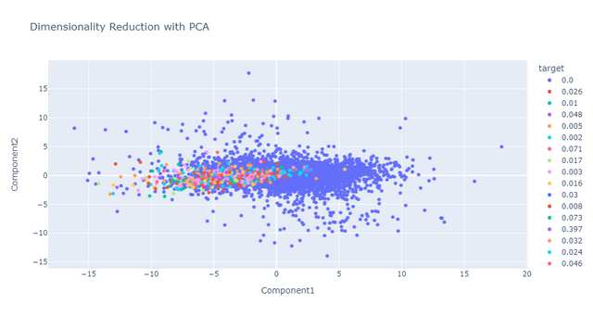
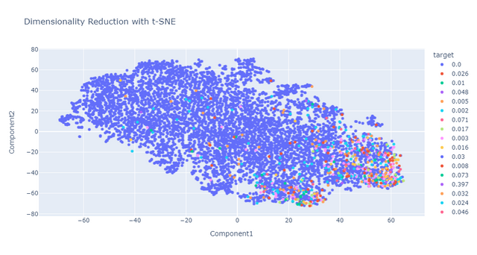
Dimensionality reduction
Players who receive MIP-shares are clustered around the x-axis (Component 2 = 0).
Players who receive MIP-shares are clustered around 4th quadrant (Component 1 > 0 and Component 2 < 0)

Slide 6

Machine Learning Results
Applied 3 different ML Algorithms: Ridge, Lasso, kNN Regressors
kNN performed the best with r² = 0.165 after tuning
Should use kNN because linear models performed poorly

Slide 7
conclusion
Linear models performed poorly, therefore the relationship between features and target is nonlinear
kNN Regressor shows promise, can also experiment with more advanced models
May improve performance by including advanced statistics, “Narrative”, and Eras

